Slide 1
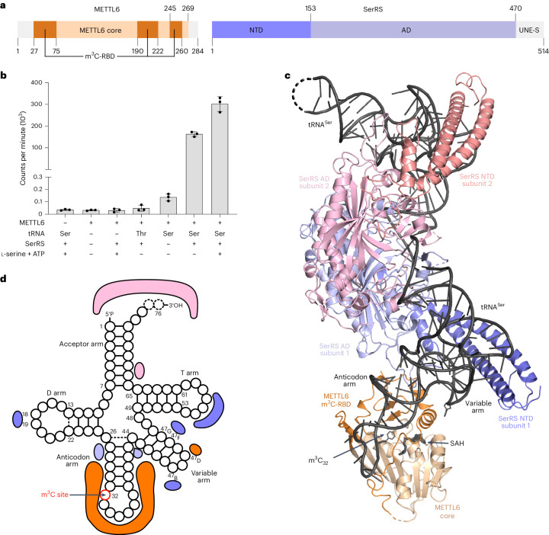
1. METTL6-SerRS ???? m3C32 ??
PMID 38918637 | Fig. 1 | Nature Structural & Molecular Biology 2024
??? METTL6?SerRS?tRNASer ???? cryo-EM ??????? m3C32 ???????
SerRS ?????????? METTL6 ? tRNASer ?????
???????m3C32?METTL6?SerRS ????A37 ???? variable arm ???
??????? + ????? + MS/?????
1

Slide 2
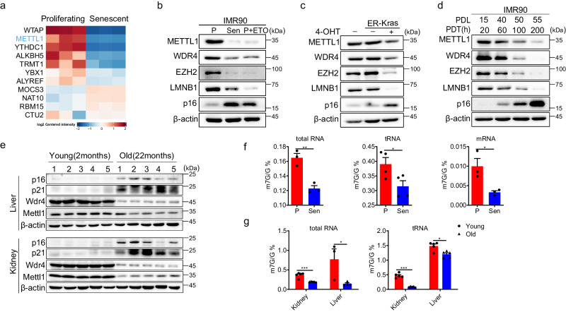
2. METTL1-WDR4/m7G46 ????????
PMID 38977661 | Fig. 1 | Nature Communications 2024
???? senescence / aging ??? METTL1-WDR4 ? RNA/tRNA m7G ?????
m7G46 ?? tRNA ????RTD????????????
???????? cleavage score?tRNA abundance?METTL1/WDR4 ????????
TRAC-seq ? m7G46 ????????
2

Slide 3
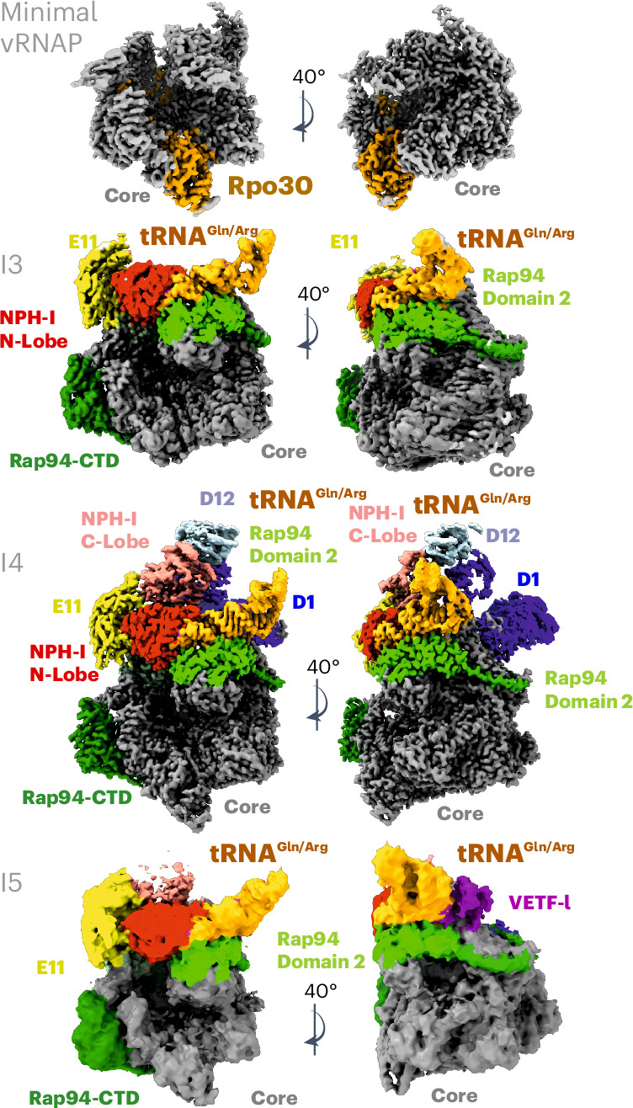
3. tRNA ????? vRNAP ????
PMID 40908366 | Fig. 2 | Nature Structural & Molecular Biology 2025
???? early PIC / vRNAP ? tRNA-chaperoned ??????
tRNAGln/Arg ??????????????????????????
?????????????????????????? mcm5s2U34?
??????? non-translational function ? viral RNP assembly ???
3

Slide 4
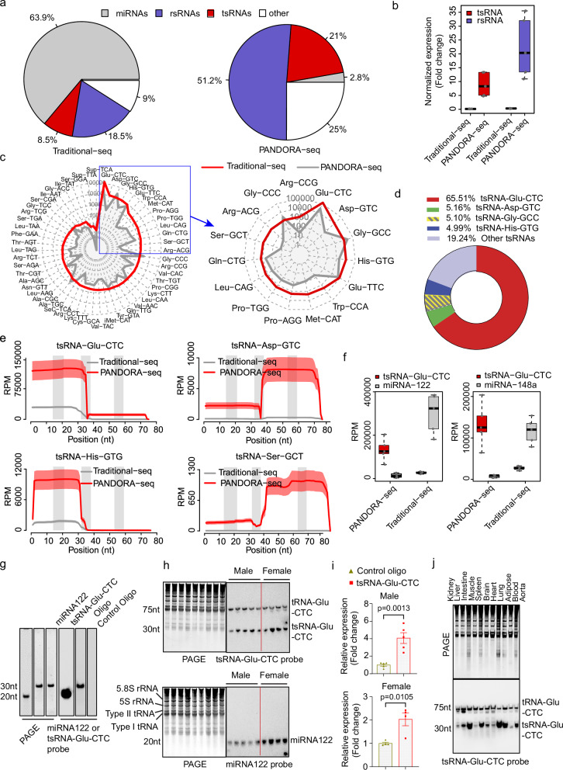
4. PANDORA-seq ?? cholesterol-responsive tsRNA
PMID 41398161 | Fig. 1 | Nature Communications 2025
?????? RNA-seq ? PANDORA-seq??? PANDORA-seq ?????? tsRNA?
tsRNA-Glu-CTC ???????????? RNA?
?? tsRNA ????MLC-seq ?????? tsRNA?????????????
????? tsRNA fragment ????????? tRNA?????????????
4

Slide 5
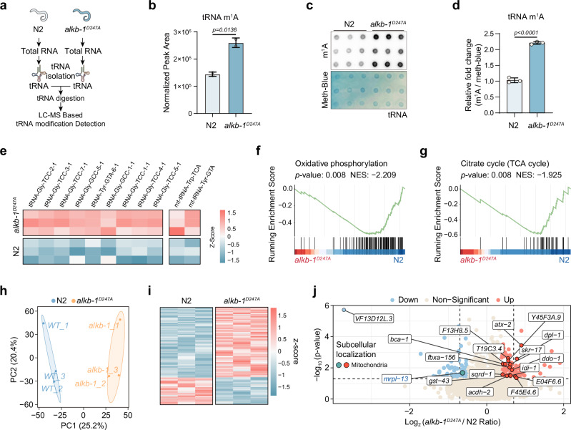
5. ALKB-1/m1A ???????????
PMID 41611679 | Fig. 2 | Nature Communications 2026
???? ALKB-1 ??? tRNA m1A ???????????????????
m1A ???? ROS?SKN-1?UPRmt????? paternal mitochondrial elimination?
?????? writer ? eraser???? demethylation-dependent ???
???????? mitochondrial proteostasis?PME?fertility/embryo viability?
5

Slide 6
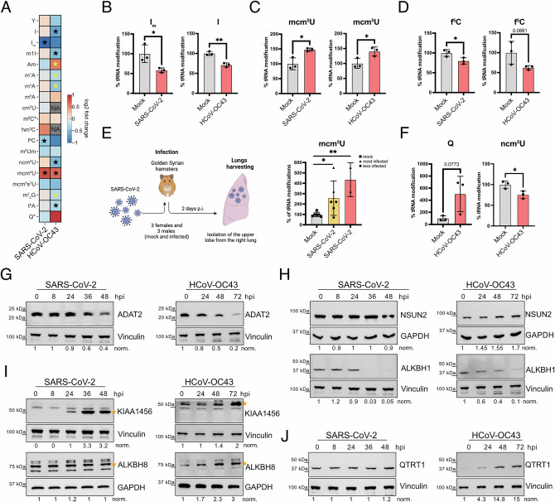
6. ????????? tRNA ????
PMID 41714626 | Fig. 3 | Nature Communications 2026
??? LC-MS/MS ?? SARS-CoV-2 ? HCoV-OC43 ???? tRNA ?????
?????? I?Q?mcm5U/mcm5s2U?m5C/f5C??????????? suboptimal codons?
mim-tRNAseq ? LC-MS/MS ????????????
?????? condition=viral infection/stress ? codon usage pressure ???
6

Slide 7
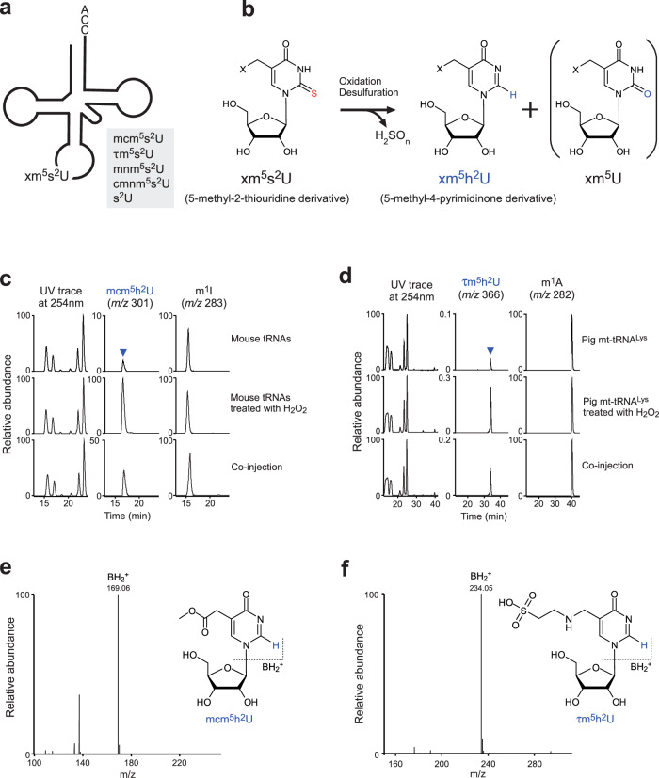
7. ????? mcm5s2U34 ????????
PMID 41807381 | Fig. 1 | Nature Communications 2026
???? U34 wobble 2-thiouridine derivatives ?????????? h2U derivatives?
mcm5h2U34 ????????? A-site codon recognition?
??????????????????????
?????redox_state?precursor_modification?converted_modification?aminoacylation effect?
7

Slide 8
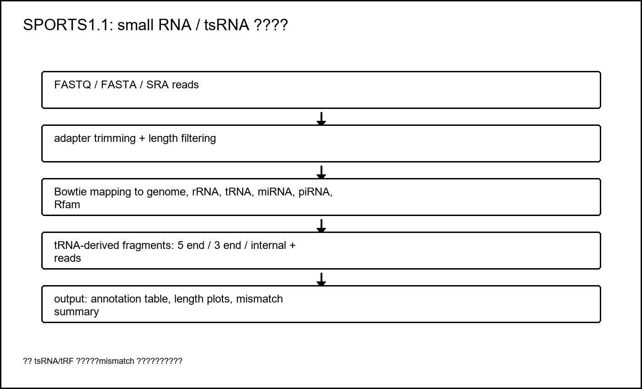
8. SPORTS1.1 ?? tsRNA/tRF ????
GitHub: junchaoshi/sports1.1
???? PANDORA-seq ? small RNA-seq??? tRNA 5 end?3 end?internal fragments?
?? reads?length?Match_Genome?Annotation ??????
?? tsRNA-Glu-CTC ?? fragment ??????
???mismatch ????????????????????
8

Slide 9
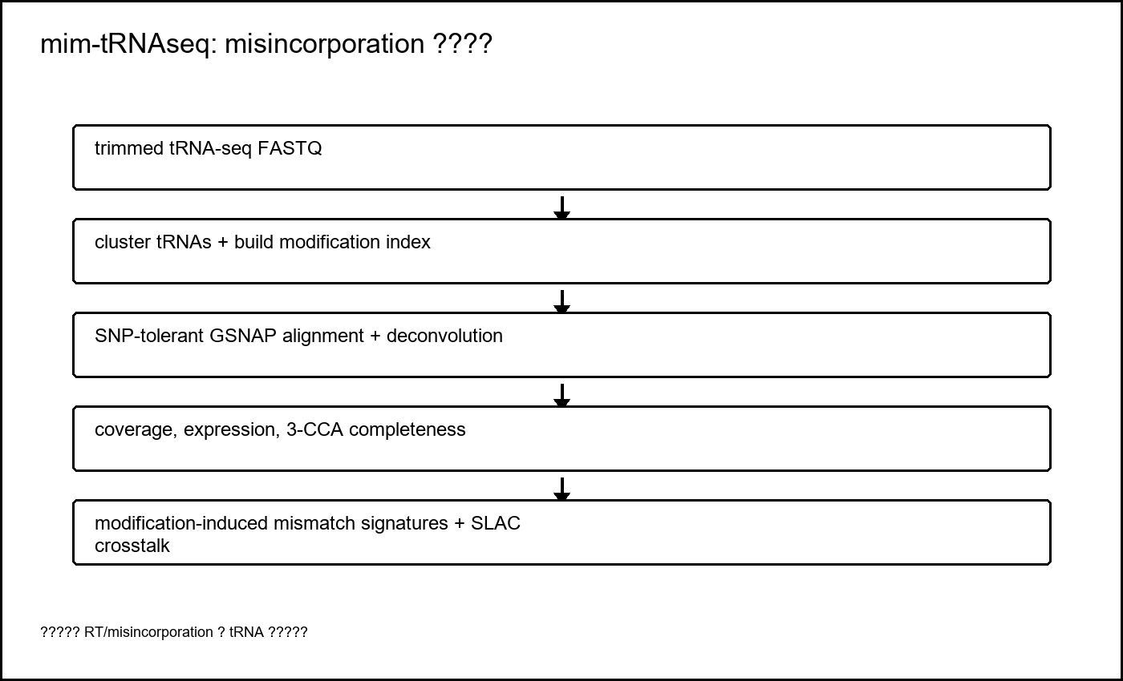
9. mim-tRNAseq ?? RT/misincorporation ????
GitHub: nedialkova-lab/mim-tRNAseq
???? tRNA ???modification index?SNP-tolerant alignment ? transcript-level deconvolution?
????? coverage?expression?3-CCA completeness?misincorporation signatures?
?? SLAC ????-?????-?????? single-read crosstalk?
???????? sequencing-inferred modification evidence ??????
9

Slide 10
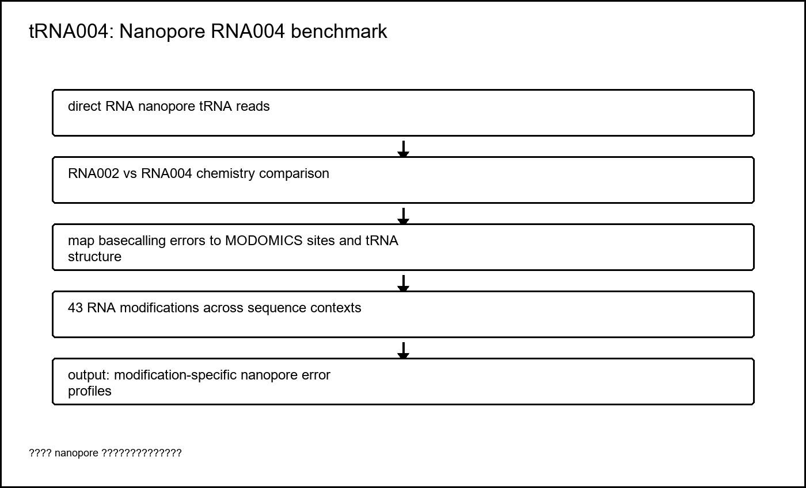
10. tRNA004 ?? Nanopore RNA004 ?? benchmark
GitHub: rnabioco/tRNA004
???? RNA002 ? RNA004 chemistry ??? tRNA ???????
? basecalling error data ??? MODOMICS ????? tRNA ???
?? 40+ / 43 ? RNA ??????????????????
?????? chemistry?basecaller?sequence context?coverage?error profile?
10

Slide 11
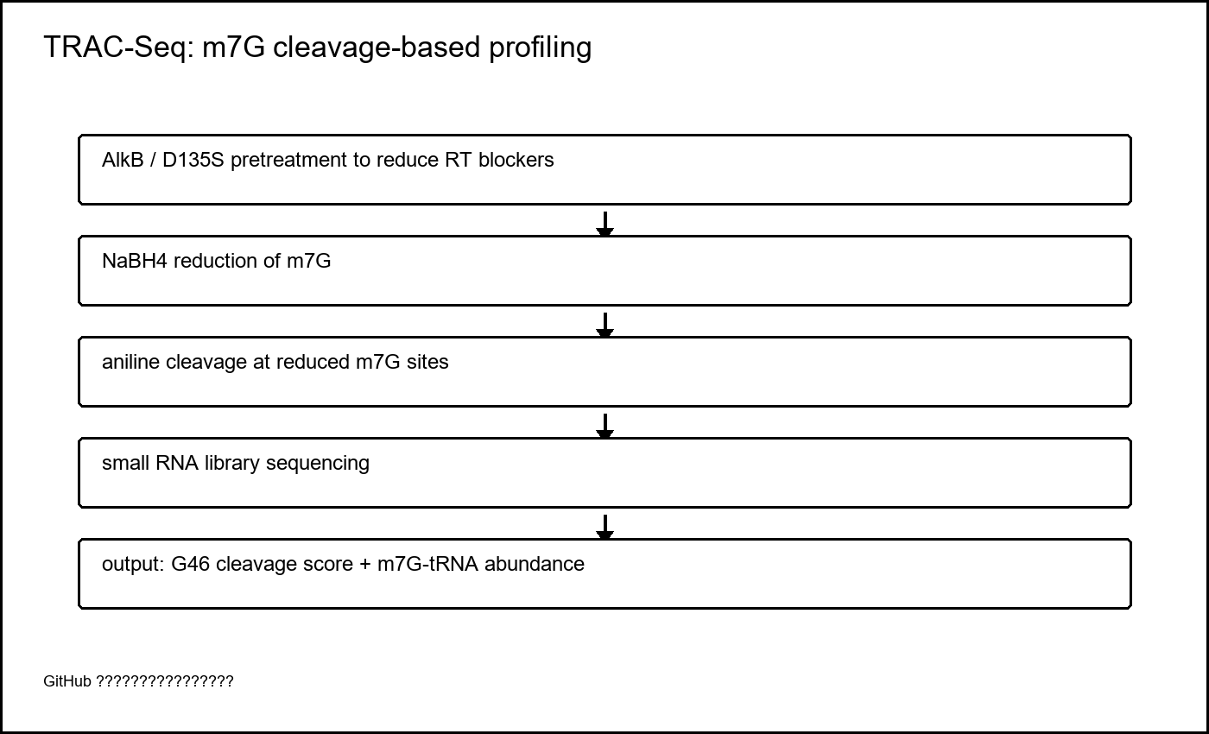
11. TRAC-Seq ? m7G46 ????????
GitHub: rnabioinfor/TRAC-Seq + PMID 38977661 ??
?? NaBH4 ?? m7G??? aniline ????????
???? cleavage score ?? m7G ??????????
???? METTL1-WDR4/m7G46 ???
?? README ??????????????????????
11

Slide 12
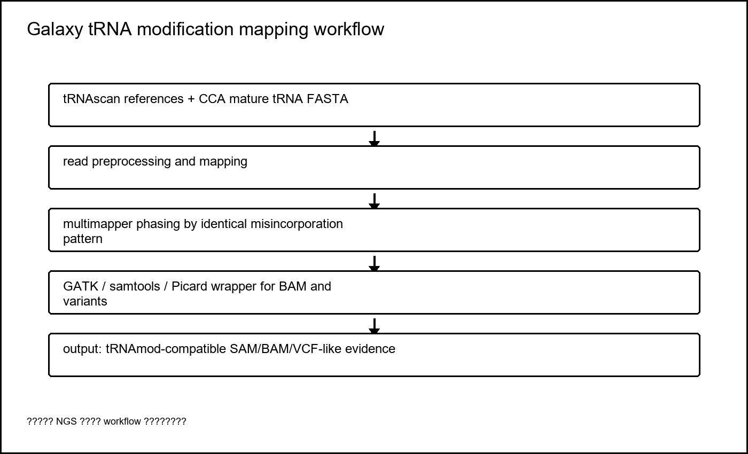
12. Galaxy workflow ???? NGS ????
GitHub: jfallmann/tRNA_ngs_mod_map_call_galaxy
?? addCCA?clustering?multimapperPhasing?GATK wrapper ????
???? reads ??? misincorporation pattern ???????
????????? mismatch/variant ??????
????? GATK 3.6 ? Galaxy ???????????
12

Slide 13
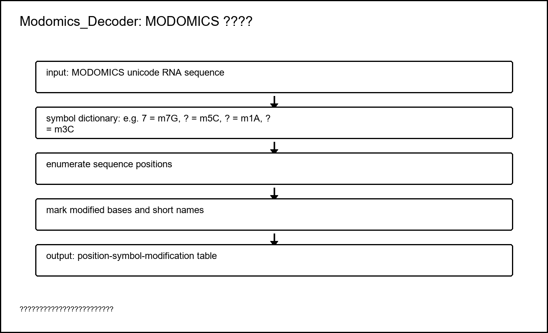
13. Modomics_Decoder ?????????
GitHub: monimaanam/Modomics_Decoder
? MODOMICS unicode sequence ?? position-symbol-short name ??
?? 7=m7G??=m5C??=m1A??=m3C?
???? reference modification import ??????
???????tRNA ????????????? MODOMICS ???
13

Slide 14
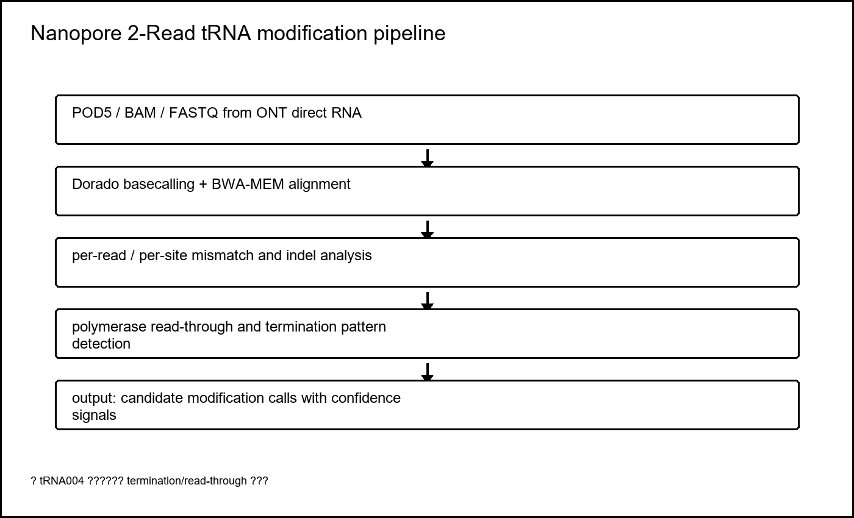
14. Nanopore 2-Read ?? termination/read-through ??
GitHub: AteeshaNegi/nanopore-2Read-trna-pipeline
???? ONT basecalling error?polymerase read-through/error ? stop sites ?????
?? per-read?per-site?single-nucleotide resolution?
??? tRNA004 benchmark ????????????
???????????????????????
14

Slide 15
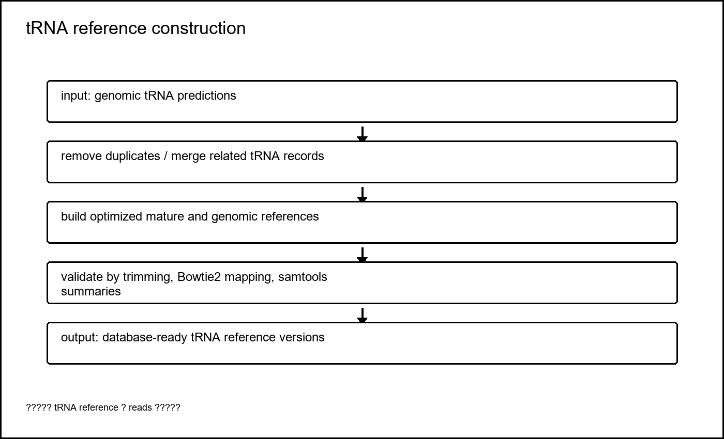
15. tRNA reference construction ?????????
GitHub: FlorianPichot/tRNA_reference_construction
? genomic tRNA predictions ?? non-duplicated?merged?optimized references?
?? reads mapping ???????
????? caller?????? reads ??????????
?????? reference_version???? mature CCA / genomic / merged ?????
15

